Slide 1
Beyond Classical Search
Shanghai Jiao Tong University

Slide 2
Outline
Local search algorithms
Hill-climbing search
Simulated annealing search
Local beam search
Genetic algorithms

Slide 3
Local search algorithms
In many optimization problems, the path to the goal is irrelevant; the goal state itself is the solution
State space = set of "complete" configurations
Find configuration satisfying constraints, e.g., n-queens
In such cases, we can use local search algorithms, keep a single "current" state, try to improve it

Slide 4

Example: n-queens
Put n queens on an n × n board with no two queens on the same row, column, or diagonal

Slide 5

Hill-climbing search
"Like climbing Everest in thick fog with amnesia"

Slide 6

Hill-climbing search
Problem: depending on initial state, can get stuck in local maxima

Slide 7

Hill-climbing search: 8-queens problem
h = number of pairs of queens that are attacking each other, either directly or indirectly
h = 17 for the above state

Slide 8

Hill-climbing search: 8-queens problem
A local minimum with h = 1

Slide 9

Simulated annealing search
Idea: escape local maxima by allowing some "bad" moves but gradually decrease their frequency

Slide 10
Local beam search
Keep track of k states rather than just one
Start with k randomly generated states
At each iteration, all the successors of all k states are generated
If any one is a goal state, stop; else select the k best successors from the complete list and repeat.

Slide 11
Outline
Local search algorithms
Hill-climbing search
Simulated annealing search
Local beam search
Genetic algorithms

Slide 12
Biological Basis
Biological systems adapt themselves to a new environment by evolution.
  Generations of descendants are produced that perform better than do their ancestors.
Biological evolution
  Production of descendants changed from their parents
  Selective survival of some of these descendants to produce more descendants

Slide 13
Evolutionary Computation
What is the Evolutionary Computation?
  Stochastic search (or problem solving) techniques that mimic the metaphor of natural biological evolution.
Metaphor（隐喻）
EVOLUTION
Individual
Fitness
Environment
PROBLEM SOLVING
Candidate Solution
Quality
Problem

Slide 14
Basic Concepts
个体 individual
种群 population
进化 evolution
适应度 fitness
选择 selection
复制 reproduction
交叉 crossover
变异 mutation

Slide 15
General Framework of EC
Generate Initial Population
Fitness Function
Evaluate Fitness
Termination Condition?
Yes
Best Individual
No
Select Parents
Crossover, Mutation
Generate New Offspring

Slide 16
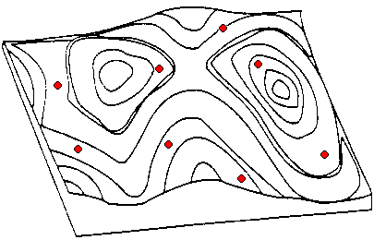
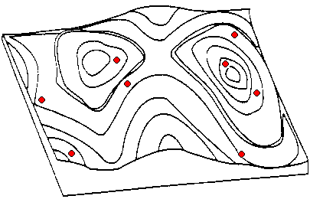
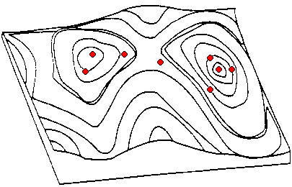
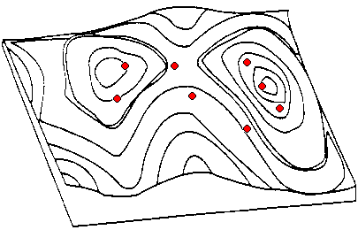
Geometric Analogy
- Mathematical Landscape

Slide 17
Paradigms in EC
Evolutionary Programming (EP)
  [L. Fogel et al., 1966]
  FSMs, mutation only, tournament selection
Evolution Strategy (ES)
  [I. Rechenberg, 1973]
  Real values, mainly mutation, ranking selection
Genetic Algorithm (GA)
  [J. Holland, 1975]
  Bitstrings, mainly crossover, proportionate selection
Genetic Programming (GP)
  [J. Koza, 1992]
  Trees, mainly crossover, proportionate selection

Slide 18
(Simple) Genetic Algorithm (1)
Genetic Representation
  Chromosome
    A solution of the problem to be solved is normally represented as a chromosome which is also called an individual.
    This is represented as a bit string.
    This string may encode integers, real numbers, sets, or whatever.
  Population
    GA uses a number of chromosomes at a time called a population.
    The population evolves over a number of generations towards a better solution.

Slide 19
Genetic Algorithm (2)
Fitness Function
  The GA search is guided by a fitness function which returns a single numeric value indicating the fitness of a chromosome.
  The fitness is maximized or minimized depending on the problems.
  Eg) The number of 1's in the chromosome Numerical functions

Slide 20
Genetic Algorithm (3)
Selection
  Selecting individuals to be parents
  Chromosomes with a higher fitness value will have a higher probability of contributing one or more offspring in the next generation
  Variation of Selection
    Proportional (Roulette wheel) selection
    Tournament selection
    Ranking-based selection

Slide 21
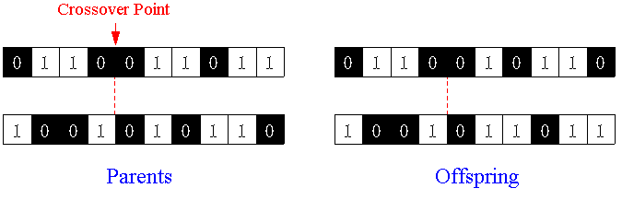
Genetic Algorithm (4)
Genetic Operators
  Crossover (1-point)
    A crossover point is selected at random and parts of the two parent chromosomes are swapped to create two offspring with a probability which is called crossover rate.
    This mixing of genetic material provides a very efficient and robust search method.
    Several different forms of crossover such as k-points, uniform

Slide 22
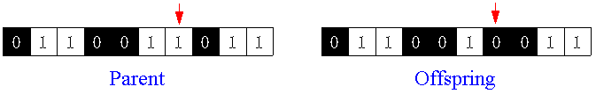
Genetic Algorithm (5)
  Mutation
    Mutation changes a bit from 0 to 1 or 1 to 0 with a probability which is called mutation rate.
    The mutation rate is usually very small (e.g., 0.001).
    It may result in a random search, rather than the guided search produced by crossover.
  Reproduction
    Parent(s) is (are) copied into next generation without crossover and mutation.

Slide 23
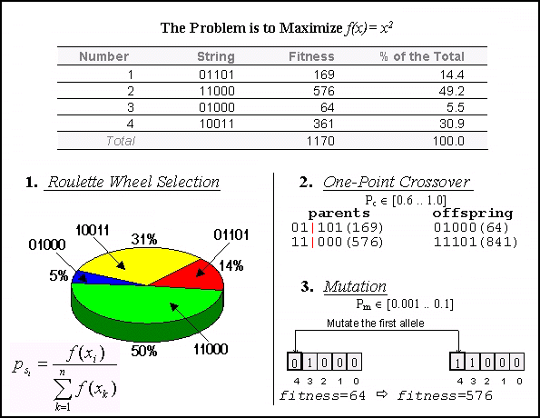
Example of Genetic Algorithm

Slide 24
Machine Programmer
Question:
  is it possible for a machine to develop a computer program to solve a problem?

Slide 25
Genetic Programming
Genetic programming uses variable-size tree-representations rather than fixed-length strings of binary values.
Program tree
= S-expression
= LISP parse tree
Tree = Functions (Nonterminals) + Terminals

Slide 26
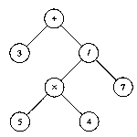
GP Tree: An Example
Function set: internal nodes
  Functions, predicates, or actions which take one or more arguments
Terminal set: leaf nodes
  Program constants, actions, or functions which take no arguments
S-expression: (+ 3 (/ (× 5 4) 7))
Terminals = {3, 4, 5, 7}
Functions = {+, ×, /}

Slide 27
Setting Up for a GP Run
The set of terminals
The set of functions
The fitness measure
The algorithm parameters
  population size, maximum number of generations
  crossover rate and mutation rate
  maximum depth of GP trees etc.
The method for designating a result and the criterion for terminating a run.

Slide 28
Crossover: Subtree Exchange
+
+
×
+
×
√
b
a
b
b
√
√
√
a
a
b
+
+
×
×
+
√
√
√
a
b
b
√
b
a
b
a

Slide 29
Mutation
+
+
/
×
/
+
b
√
a
b
b
√
√
-
a
a
b
b
a

Slide 30
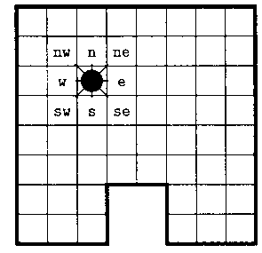
Example: Wall-Following Robot
Program Representation in GP
  Functions
    AND (x, y) = 0 if x = 0; else y
    OR (x, y) = 1 if x = 1; else y
    NOT (x) = 0 if x = 1; else 1
    IF (x, y, z) = y if x = 1; else z
  Terminals
    Actions: move the robot one cell to each direction {north, east, south, west}
    Sensory input: its value is 0 whenever the coressponding cell is free for the robot to occupy; otherwise, 1. {n, ne, e, se, s, sw, w, nw}

Slide 31
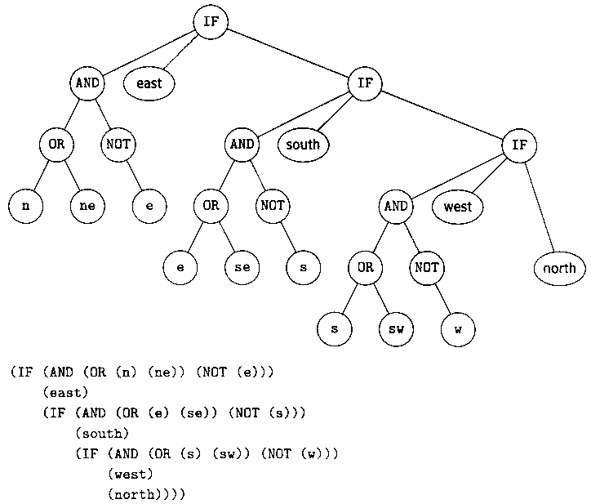
A Wall-Following Program

Slide 32
Evolving a Wall-Following Robot
Experimental Setup
  Population size: 5,000
  Fitness measure: the number of cells next to the wall that are visited during 60 steps
    Perfect score (320)
      One Run (32) × 10 randomly chosen starting points
  Termination condition: found perfect solution
  Selection: tournament selection

Slide 33
Creating Next Generation
  500 programs (10%) are copied directly into next generation.
    Tournament selection
      7 programs are randomly selected from the population 5,000.
      The most fit of these 7 programs is chosen.
  4,500 programs (90%) are generated by crossover.
    A mother and a father are each chosen by tournament selection.
    A randomly chosen subtree from the father replaces a randomly selected subtree from the mother.
  In this example, mutation was not used.

Slide 34
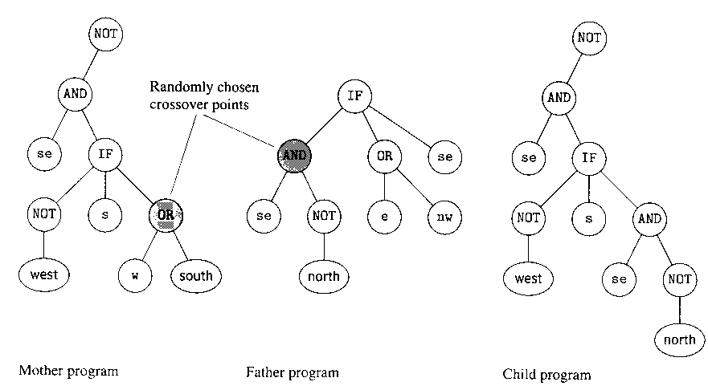
Two Parents Programs and Their Children

Slide 35
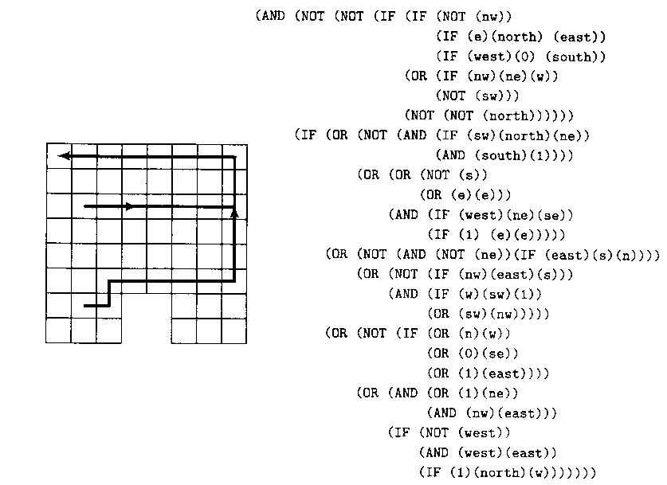
Result (1)
Generation 0
  The most fit program (Fitness = 92)

Slide 36
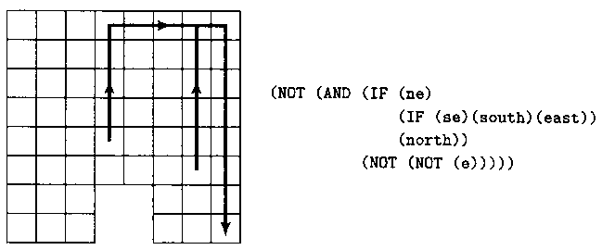
Result (2)
Generation 2
  The most fit program (fitness = 117)
    Smaller than the best one of generation 0, but it does get stuck in the lower-right corner.

Slide 37
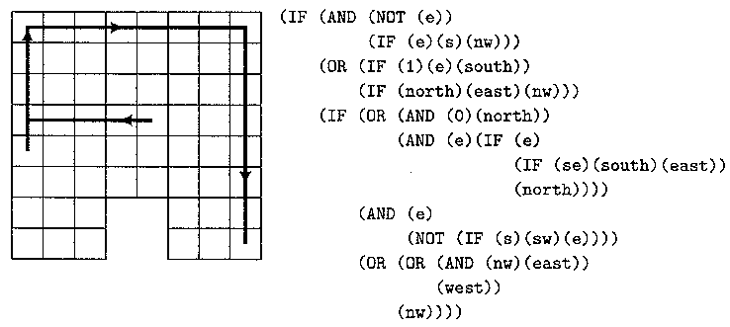
Result (3)
Generation 6
  The most fit program (fitness = 163)
    Following the wall perfectly but still gets stuck in the bottom-right corner.

Slide 38
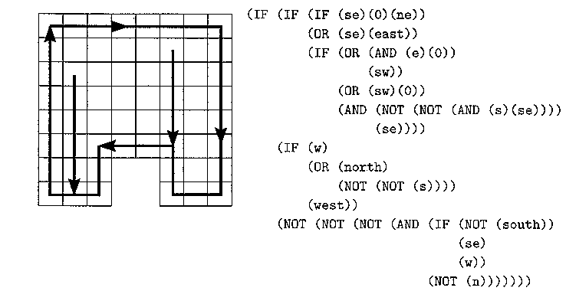
Result (4)
Generation 10
  The most fit program (fitness = 320)
    Following the wall around clockwise and moves south to the wall if it doesn’t start next to it.

Slide 39
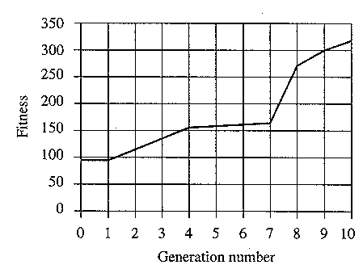
Result (5)
Fitness Curve
  Fitness as a function of generation number
    The progressive (but often small) improvement from generation to generation

Slide 40

Genetic algorithms

Slide 41
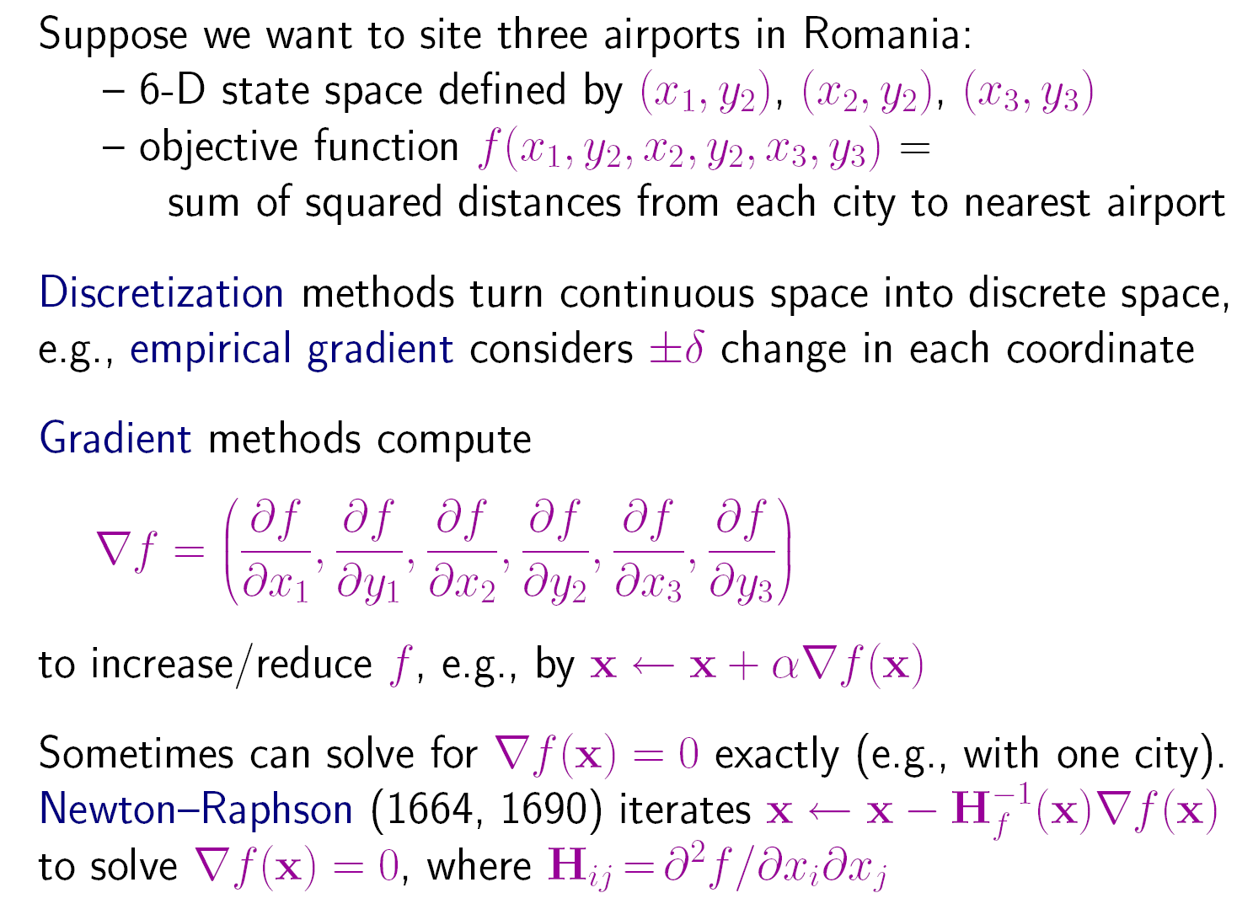

Local Search in Continuous Spaces

Slide 42
First Project: 8-queens Problem
To formulate 8-queens problem into the search problem in a state space
To define a evaluation function
To implement local Algorithm to estimate the rate of falling into local minimums.
To write a report on the simulation result.

Slide 43
Questions?
What further problems will we meet?
  Constraints
  Multi-agents
  Uncertainty

Slide 44
The Go Text Protocol(GTP)
http://www.lysator.liu.se/~gunnar/gtp/
http://sourceforge.net/projects/gogui/

Slide 45
End of the Talk

